Slide 1

LCA’s
Video Law Library
Representing the LCA Music Client:
Band Formation
Speakers:
Barry Irwin | Irwin IP
Peter Strand | Leavens, Strand & Glover

Slide 2

Band Formation:
Agreements Among Band Members
  Fundamental issues to address
    Band Member jobs and responsibilities
    How to split profits from gigs
    How to split merchandise profits
    How the band should make future decisions
      Majority vs. Unanimous vote
    How to determine songwriting credits
    Who owns the band name
    What to do if a band member wants to quit

Slide 3
Band Formation:
Choice of Entity
  General Partnership
  “S” Corporation
  Limited Liability Company (LLC)

Slide 4
General Partnership:
Advantages and Disadvantages
  Advantages
    Simplicity – minimal startup requirements, flexibility in structuring operations, and no required state filings.
  Disadvantages
    Personal Liability – each band member can be held personally responsible for the acts and debts of the band as an entity.

Slide 5
General Partnership:
Drafting the Partnership Agreement
    Defining scope of band partner services
      Contributions to sound recordings as well as live performances
    Restrictions on non-band partner activities
    Explicit rejection of employer-employee relationship
    Establishment of Name/Logo/etc.
    Rules for meetings
      Including delineation of which matters require a unanimous vote and which require a simple majority

Slide 6
General Partnership:
Drafting the Partnership Agreement
    Ownership of Sound Recordings
      Will Copyrights be registered in the name of the Band Partnership or each Band Partner?
    Ownership of Musical Compositions/Publishing Rights and division of publishing income
    Band Partner Contributions – amount, frequency, etc.
    Profit and Loss Sharing
    Accounting procedures

Slide 7
General Partnership:
Drafting the Partnership Agreement
    Dissolution – what happens when the band dissolves, or even when a band member leaves
    Procedures for addition of new members
    Rights and Duties of former members
    Additional Boilerplate
      Warranties and Indemnification
      Notices
      Waiver
      Choice of Law
      Mediation/Arbitration
      Etc.

Slide 8
“S” Corporation:
Advantages and Disadvantages
  Advantages
    Limited liability protection
    Single taxation
    Reduced annual cost (as compared to LLCs)
  Disadvantages
    Rigid management structure
    Onerous ongoing requirements

Slide 9
“S” Corporation:
Formation Checklist
  Articles of Incorporation
  By-laws
  Organizational Consents
  Stock Certificate and Receipts
  Shareholders Agreement
  Employer Identification Number
  S-election form
  Disclosure Document
  Annual Consents
  Annual Report filing with Secretary of State

Slide 10
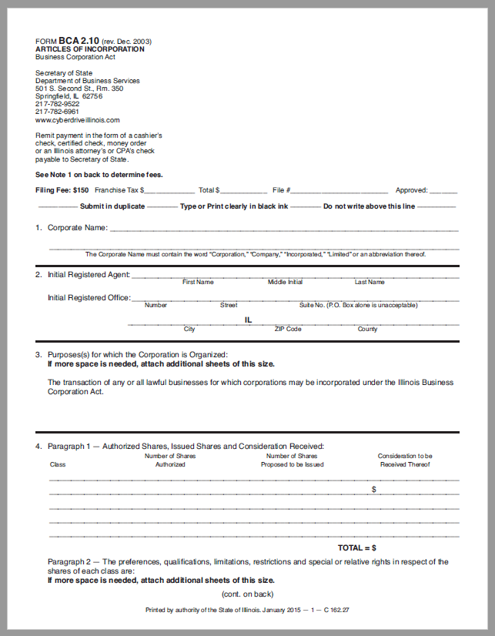
“S” Corporation:
Articles of Incorporation
Filing Fee - $150.00
Corporate Name
Registered Agent & Office
Purpose of the Corporation
Shares
Form available in Supplementary Materials
as well as via www.cyberdriveillinois.com

Slide 11
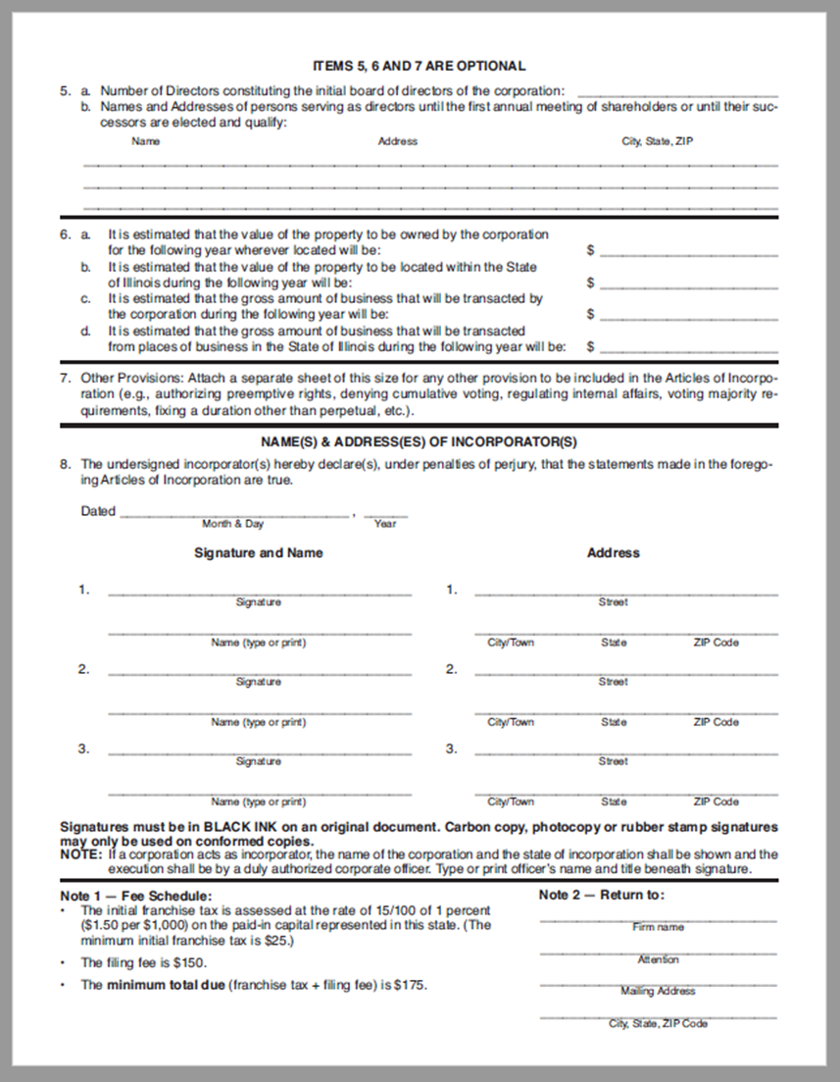
“S” Corporation:
Articles of Incorporation
Initial Board of Directors
Corporate Property and Estimated Business
Additional Provisions
Incorporators
Form available in Supplementary Materials
as well as via www.cyberdriveillinois.com

Slide 12
“S” Corporation:
By-laws
  Common Provisions
    Offices
    Recordkeeping procedures
    Meetings and relevant procedures
      Including voting and attendance rules
    Board of Directors
      Rights and Responsibilities
    Officers
    Shares and transfer thereof
    Contract/Loan/Deposit Authority
    Indemnification
    Miscellaneous

Slide 13
“S” Corporation:
Organizational Consent
MEMORANDUM OF RECORDING
The original of the Articles of Incorporation, File No. [File Number], immediately following this Memorandum, was filed for record in the Office of the Recorder of Deeds of [County], Illinois, on [Date] as document number [Document Number].

Slide 14
“S” Corporation:
Organizational Consent
[BAND CORP.]
CONSENT OF SOLE INCORPORATOR TO ADOPTION OF RESOLUTION
IN LIEU OF ORGANIZATIONAL MEETING
_________________________________
The undersigned, being the sole incorporator of [BAND CORP.]., an Illinois corporation, pursuant to Sections 2.05 and 2.20 of the Illinois Business Corporation Act of 1983, consents in writing to the adoption of the following resolution in lieu of an organizational meeting:
RESOLVED, that the following named persons are elected to serve as directors of the Corporation, to serve until the first annual meeting of the shareholders and until their successors are elected and qualified:
[Board Member 1]
[Board Member 2]
[Board Member 3]
Dated as of [Date]
_______________________________
[Name of Incorporator]

Slide 15
“S” Corporation:
Organizational Consent
There will also be a document memorializing the consent of the Board of Directors regarding:
  Ratification of actions of the incorporator
  Adoption of By-Laws
  Election of Officers
  Issuance of shares
  Fiscal Year
  Bank Accounts
Organizational Consent Documentation Available in Supplementary Materials

Slide 16
“S” Corporation:
Stock Legends
LEGENDS TO ADD TO REVERSE SIDE TO STOCK CERTIFICATES
The securities represented by this certificate have been acquired for investment and has not been registered under the Securities Act of 1933, as amended, or any applicable state securities laws. Without such registration, such securities may not be sold or otherwise transferred at any time whatsoever unless, in the opinion of counsel satisfactory to the Company, (1) registration is not required for such transfer and (2) such transfer will not be in violation of the Act or applicable state securities laws, or any rule or regulation promulgated thereunder.
The sale or transfer of this certificate is subject to an agreement between the Shareholders dated [Date of Shareholder’s Agreement]. A copy of this Agreement is on file in the Office of the Secretary of the Corporation.

Slide 17
“S” Corporation:
Shareholders Agreement
    Basic Provisions
      Name of band
      Details of formation
      Term of agreement
      Place of business
      Purpose
      Directors and Officers

Slide 18
“S” Corporation:
Shareholders Agreement
  Distribution of Profits – Sample Provision
  Net Profits shall be equally distributed to the Shareholders from time to time as authorized by the Board of Directors. The aggregate amounts distributed to the Shareholders from the Corporation's profits shall not, however, exceed the amount of cash available for distribution, taking into account the Corporation's reasonable working capital needs as determined by the Board of Directors.
  For the purpose of this Agreement, "Net Profits" shall mean all income, advances, royalties, license fees, commissions, bonuses, payments (other than repayment of loans), interests or monies of any kind or nature paid to the Corporation after deducting the sum total of all expenses, including, but not limited to, salaries, management fees, license fees, royalties, rent, promotional costs, travel costs, office expenditures, telephone costs, accounting and legal fees, entertainment costs and any and all other Corporation expenses incurred by the Corporation while conducting Corporation business.
  The Corporation shall distribute to each Shareholder on or before sixty (60) days after the end of each fiscal year an amount sufficient to cover such Shareholder’s tax obligation as a shareholder in a “S” Corporation for such fiscal year.

Slide 19
“S” Corporation:
Shareholders Agreement
    Shareholders
      Rights and Obligations
      Restriction on transfer of shares
    Assets of the Corporation
    Corporate Bank Accounts
    Miscellaneous
      Insurance
      Construction/Severability
      Modification

Slide 20
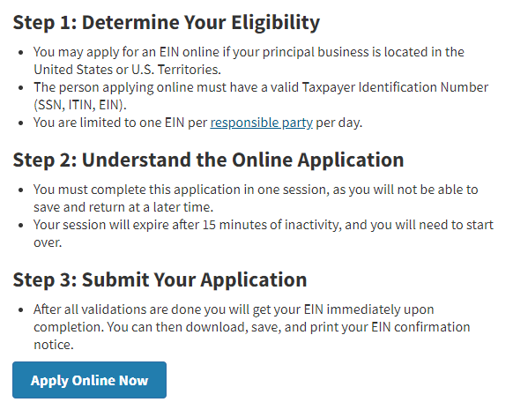
“S” Corporation:
Employer Identification Number (EIN)
Sometimes referred to as a Tax Identification Number (TIN)
  Can obtain online

Slide 21
“S” Corporation:
S-Election – IRS Form 2553
  Necessary to obtain Single Taxation benefit
  Requirements
    Domestic Corporation
    No more than 100 shareholders
    Shareholders are individuals, estates, other exempt organizations, or trusts
    No nonresident alien shareholders
    One class of stock
    Cannot be
      Bank, insurance company, possessions corporation, DISC
    Must have one of the permitted tax years
      Ends 12/31, natural business year, ownership tax year, etc.
    Consent of Shareholders

Slide 22
“S” Corporation:
Disclosure Document
  Often a letter directed to the new “Band Corp.”
    Explain corporate formalities and operating procedures
      Minute Book
      Annual Report
      Annual Meetings
      Tax Returns
      Changed Circumstances

Slide 23
“S” Corporation:
Annual Consents
  Adoption of Resolutions in Lieu of Annual Meeting
    Ratification of Prior Acts
    Shareholders’ Election of Directors
    Directors’ Election of Officers

Slide 24
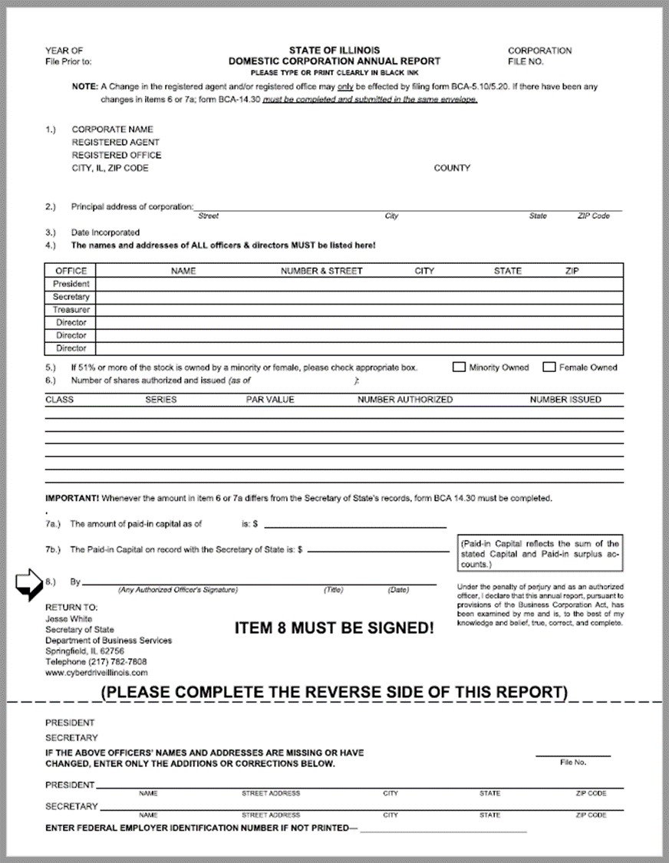
“S” Corporation:
Annual Report
Basics
  Identifying Information
  Principal Address
  Date of Incorporation
Officers and Directors
Authorized and Issued Shares
Paid-in Capital
Form available in Supplementary Materials
as well as via www.cyberdriveillinois.com

Slide 25
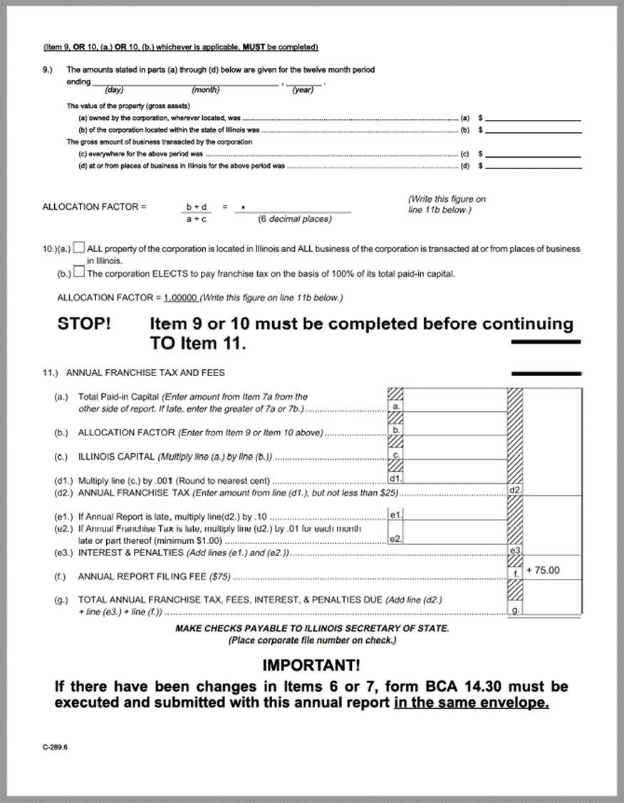
“S” Corporation:
Annual Report
Allocation of Assets and Property
Annual Franchise Tax and Fees
Form available in Supplementary Materials
as well as via www.cyberdriveillinois.com

Slide 26
LLC:
Formation Checklist
  Articles of Organization
  Operating Agreement
  EIN Application
  Disclosure Letter
  Annual Report

Slide 27
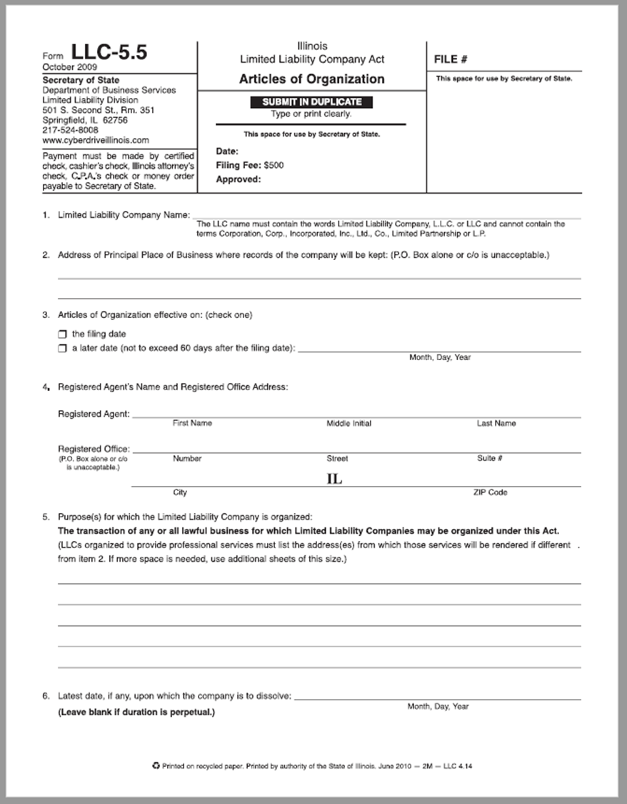
LLC:
Articles of Organization
Basics
  Name
  Principal Place of Business
  Effective Date
  Registered Agent & Office
Purpose
Duration
Form available in Supplementary Materials
as well as via www.cyberdriveillinois.com

Slide 28
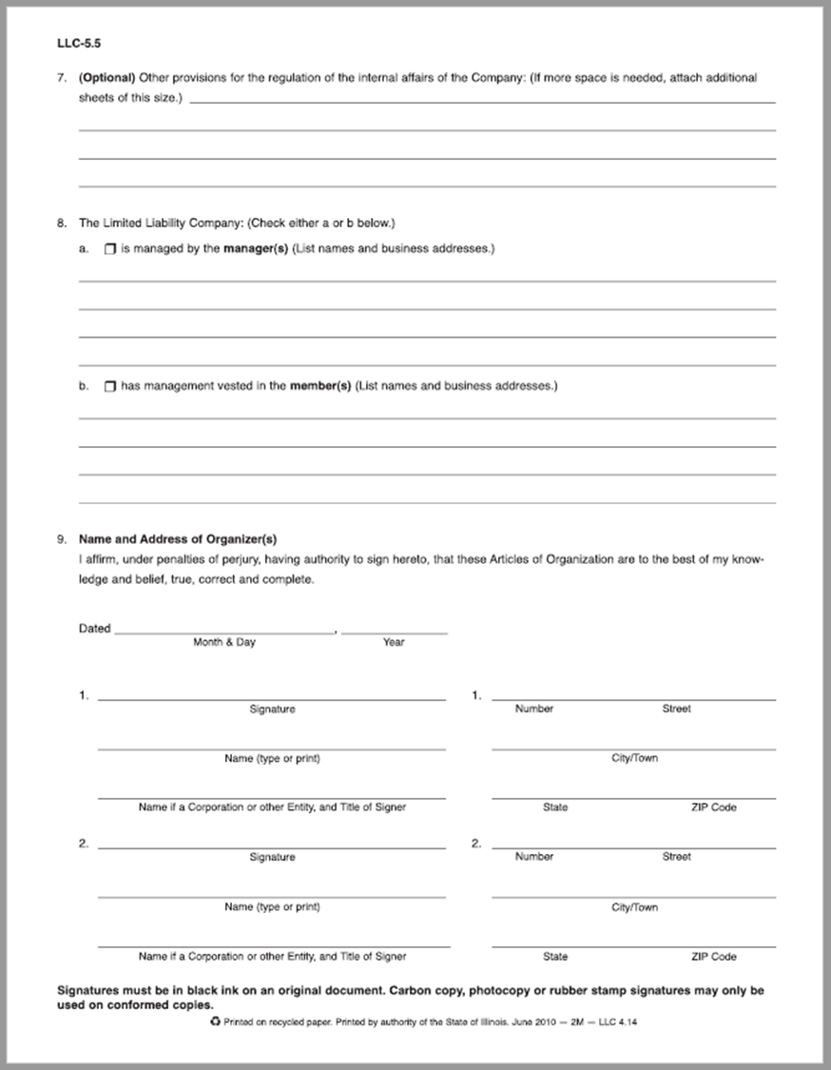
LLC:
Articles of Organization
Regulation of Internal Affairs
Member vs. Manager Managed
Organizers
Form available in Supplementary Materials
as well as via www.cyberdriveillinois.com

Slide 29
LLC:
Operating Agreement
    Formation of LLC
    Assets
      Name
      Albums
      Domain
    Definitions
    Purpose
    Members
    Term
    Principal Office

Slide 30
LLC:
Operating Agreement
    Capital Contributions
      Initial
      Additional
      Capital Accounts
    Distributions and Payments
    Allocations of Profits and Losses
    Books and Records
    Fiscal Year
    Company Funds
    Rights and Duties of Members

Slide 31
LLC:
Operating Agreement
    Meetings of Members
      Place
      Quorum
      Voting
    Powers, Rights, and Duties of the Manager
    Transfer of Membership Interest
    Dissolution
    Amendment of Operating Agreement and Articles of Organization
    Admission of New Members
    Miscellaneous

Slide 32
LLC:
Employer Identification Number (EIN)
Sometimes referred to as a Tax Identification Number (TIN)
  Can obtain online

Slide 33
LLC:
Disclosure Document
  Often a letter directed to the new “Band LLC”
    Explain LLC formalities and operating procedures
      Record Book
      Annual Report
      Tax Returns
      Changed Circumstances

Slide 34
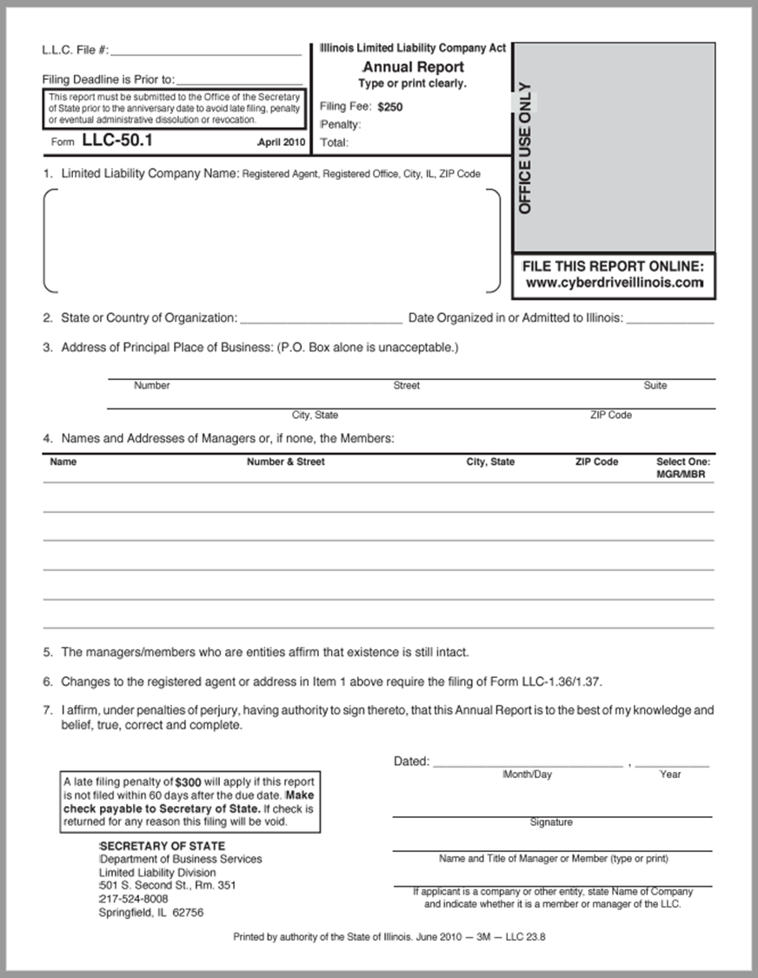
LLC:
Annual Report
Identifying Information
Principal Place of Business
Names/Addresses
  Managers if Manager-Managed
  Members if Member-Managed
Affirmation
Form available in Supplementary Materials
as well as via www.cyberdriveillinois.com

Slide 35
Choice of Entity:
Recap
  General Partnership
  “S” Corporation
  Limited Liability Company (LLC)

Slide 36
About LCA
Lawyers for the Creative Arts is an Illinois nonprofit organization providing pro bono legal services to individuals and organizations engaged in all areas of the arts – the visual, music, performing and literary arts, as well as arts education and nonprofit organizations in general. Services are provided by LCA staff and a roster of volunteer attorneys experienced in all areas of law which affect the arts. LCA also provides mediation and facilitation services through its Patricia Felch Arts Mediation Service and numerous educational outreach programs. To apply for legal help on your arts-related matters, complete the form at www.law-arts.org/application.

Slide 37
About LCA
This project is partially supported by a CityArts Grant from the City of Chicago Department of Cultural Affairs & Special Events, and by the Chicago Community Trust. Other funding gratefully acknowledged from Alphawood Foundation, The Chicago Bar Foundation, Gaylord and Dorothy Donnelley Foundation, The Richard H. Driehaus Foundation, and the Illinois Arts Council, a State Agency.

Slide 38
Thanks for viewing
For more information on this topic, as well as model agreements, please see the Supplementary Materials included with this CLE program.
Please check out the remainder of our series on Representing the LCA Music Client and the rest of the LCA Video Law Library.

